Slide 1
QO-100 RTX basic version
SDR Console 3.4
PC WIN 11
Ethernet HUB
Bias-T
PLUTO PLUS
PreAmp VGA V2
Filter/Att. -3 to -6db
DISH
PA 20W
LNB 10.5 GHZ
-9750 Mhz
Illuminator 2.4 GHZ

Slide 2
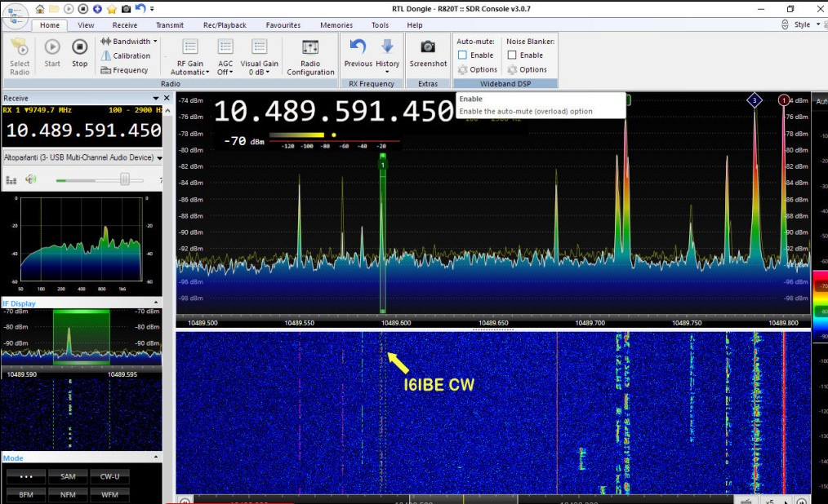
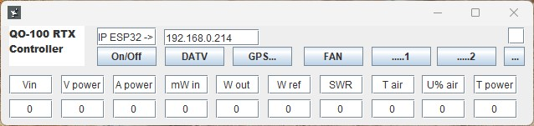
QO-100 RTX next step
PC WIN 11
SDR Console 3.4
Ethernet HUB + WiFi
Bias-T
PLUTO PLUS
PreAmp VGA V2
Power Supply and ESP32 controller
+5V
+12V
+18V
+28V
Filter/Att.
-3 to -6db
GPSDO
PA 20W
Win​ Wfwd​ Wref​
DISH
WiFi
LNB 10.5 GHZ
-9750 Mhz
Illuminator 2.4 GHZ
PreAmp and PA from SG-Lab
https://github.com/apozzon/QO-100_RTX_CONTROLLER

